Slide 1
Traditional Chinese Authority URI enrichment to Linked Data
Yoel Kortick
Senior Librarian

Slide 2

Introduction
The sample record
The linked data with Traditional Chinese Authority URI enrichment
The Linked Data in MARC21
The Linked Data in BIBFRAME
The Linked Data in RDA-RDF
The Linked Data in JSONLD
Agenda

Slide 3
Introduction

Slide 4
Introduction
The Jan. 2022 release includes Traditional Chinese Authority URI enrichment to Linked Data.
The Linked Data for the Traditional Chinese Authority data can come from three sources:
  Name Authority: http://ld.ncl.edu.tw/authority (Code: TWNAF)
  Subject term: http://ld.ncl.edu.tw/subject (Code: LCSTT)
  Classification scheme: http://ld.ncl.edu.tw/classification (Code: NCSCLT)

Slide 5
Introduction
The three sources of the URI enrichment for the Traditional Chinese authorities are in the Alma Community Zone, and are explained in Authority Vocabularies in the Community Zone
  The Name Authority TWNAF is the "Taiwan Name Authority File"
  The Subject Term LCSTT is the "List of Chinese Subject Terms"
  The Classification Scheme NCSCLT is "New classification scheme for Chinese libraries"

Slide 6
Introduction
This is beneficial because now there are yet more sources to enrich the data in discovery, thereby providing users with additional access points.

Slide 7
The sample record

Slide 8
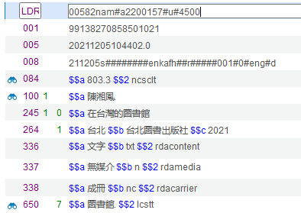
The sample record
A heading linked to the Classification Scheme NCSCLT
A heading linked to the Name Authority TWNAF
A heading linked to the Subject Term LCSTT

Slide 9
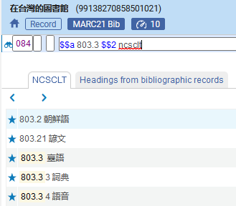
The sample record
Doing F3 on the 084 (Other Classification Number) field we can see that the heading is connected to NCSCLT

Slide 10
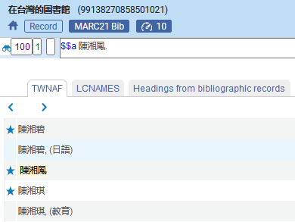
The sample record
Doing F3 on the 100 (Main Entry - Personal Name) field we can see that the heading is connected to TWNAF

Slide 11
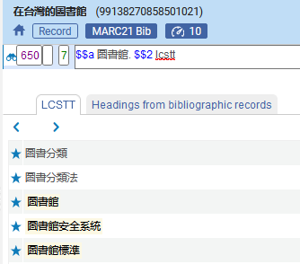
The sample record
Doing F3 on the 650 (Subject Added Entry - Topical Term) field we can see that the heading is connected to LCSTT

Slide 12
The linked data with Traditional Chinese Authority URI enrichment

Slide 13
The linked data with Traditional Chinese Authority URI enrichment
As explained in the Linked Data explanation on the Ex Libris Developers Network, the Linked data can be exposed in several formats. Alma supports the following LD formats:
  BIBFRAME
  JSON-LD
  RDA-RDF

Slide 14
The Linked Data in MARC21

Slide 15
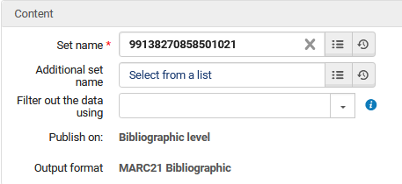
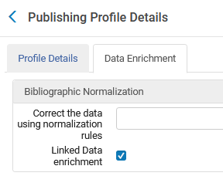
The linked data in MARC21
First, we will check the results of a general publishing profile which includes MARC21 format with Linked Data enrichment:

Slide 16
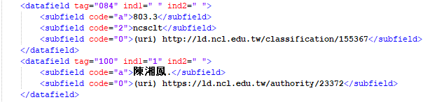

The linked data in MARC21
Here is the Linked Data enrichment in the output file:

Slide 17
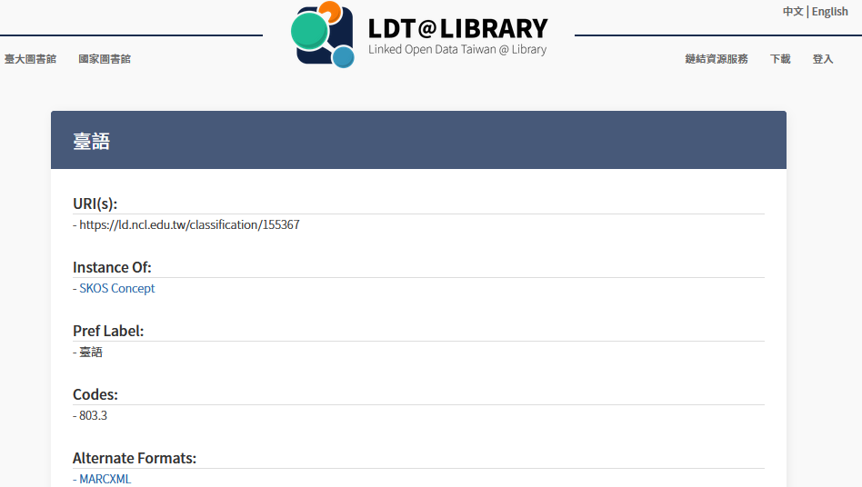
The linked data in MARC21
Here is the first URL of the Linked Data enrichment: http://ld.ncl.edu.tw/classification/155367

Slide 18
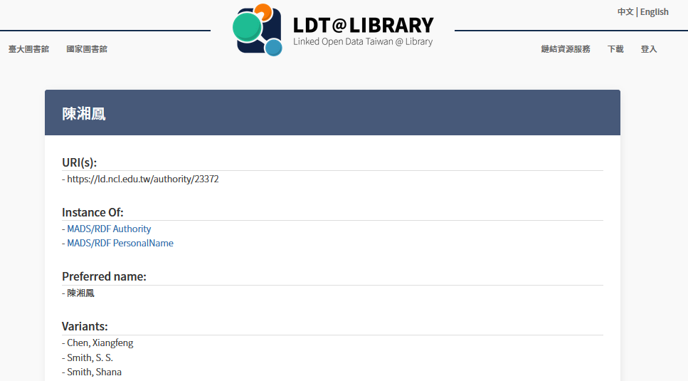
The linked data in MARC21
Here is the second URL of the Linked Data enrichment: https://ld.ncl.edu.tw/authority/23372

Slide 19
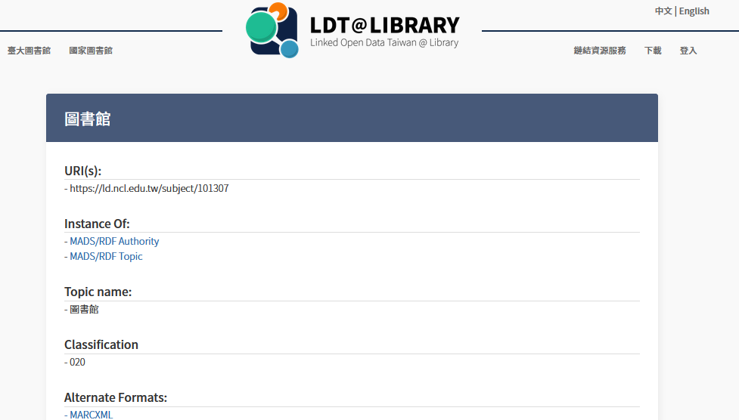
The linked data in MARC21
Here is the third URL of the Linked Data enrichment: https://ld.ncl.edu.tw/subject/101307

Slide 20
The linked data in MARC21
Note that here we showed the classifications in the linked data in MARC21.
Our example was http://ld.ncl.edu.tw/classification/155367
While displaying the classifications is supported in linked data in MARC21, note that it is not supported for BIBFRAME, JSONLD and RDA-RDF format.
Thus, in the following examples we will look at the names and subjects, but not the classifications.

Slide 21
The Linked Data in BIBFRAME

Slide 22
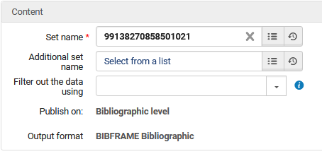
The linked data in BIBFRAME
Now we will check the results of a general publishing profile which includes BIBFRAME format with Linked Data enrichment:

Slide 23
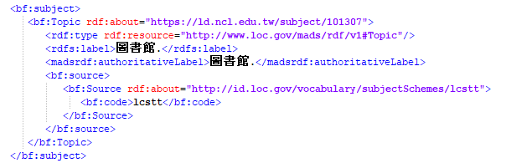
The linked data in BIBFRAME
Here is the subject in BIBFRAME format with Linked Data enrichment:

Slide 24
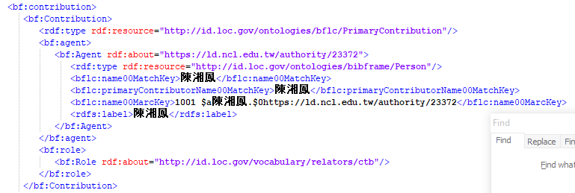
The linked data in BIBFRAME
Here is the name (contribution) in BIBFRAME format with Linked Data enrichment:

Slide 25
The Linked Data in RDA-RDF

Slide 26
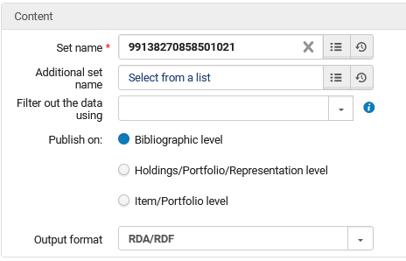
The linked data in RDA-RDF
Now we will check the results of a general publishing profile which includes RDA-RDF format with Linked Data enrichment:

Slide 27
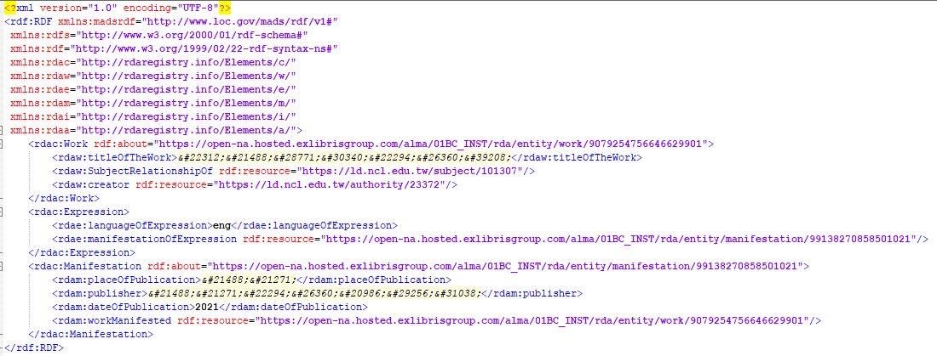
The linked data in RDA-RDF
Here is the name (creator) and subject in RDA-RDF format

Slide 28
The Linked Data in JSONLD

Slide 29
The linked data in JSONLD
Now we will check the Linked Data enrichment in JSONLD.
One way to get the JSONLD version is to open the record in the metadata editor and do "View related Data > View Linked Data".
On this page the JSON-LD data appears in a table view and not as "native" JSON.

Slide 30
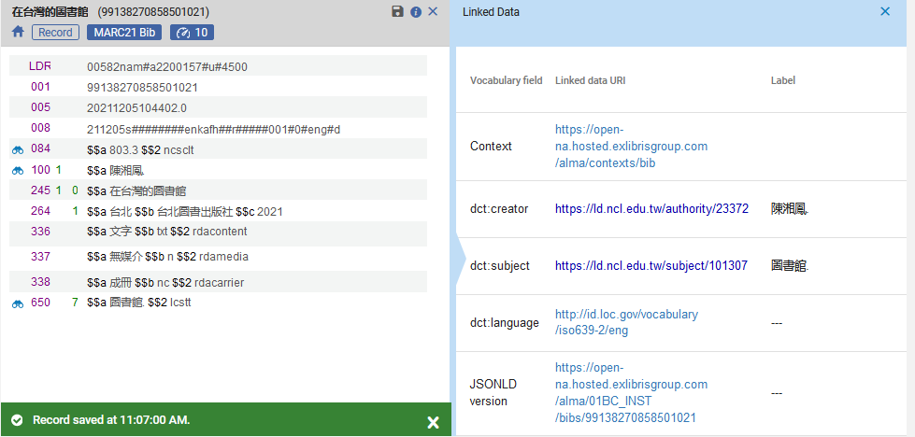
The linked data in JSONLD
Here is the name (creator) and subject in JSONLD format:

Slide 31
Yoel.Kortick@exlibrisgroup.com

